Slide 1
CAPSTONE PROJECT
TreasuryAudit360
Automated audit of a bank’s treasury with n8n, Claude AI and rule-based CAATs
RBI
SEBI
IFSCA
FEMA
ICAI Standards on Auditing
CA Ravishankar Balakrishnan Aiyar
Membership No. 040524 · Batch AIL2B105
Live app: treasuryaudit360.lovable.app
CA Ravishankar Balakrishnan Aiyar | Mem. No. 040524 | CAPSTONE PROJECT – TREASURYAUDIT360
1
Notes:
SCENE 1 (face, 0:00-0:40). Good morning. I am CA Ravishankar Balakrishnan Aiyar, membership number 040524, from batch AIL2B105. My capstone project is TreasuryAudit360: an end-to-end automated audit of the treasury department of an Indian bank. It tests every treasury deal against RBI, SEBI, IFSCA and FEMA rules, documents the work to ICAI Standards on Auditing, and uses AI to draft the Audit Committee report. It is built with three AI models (Claude Opus, Claude Sonnet and the Lovable AI agent), and the code is written mainly in TypeScript and JavaScript. In the next ten minutes I will show the problem, the solution, the AI and the code behind it, and a live audit run.

Slide 2
Manual treasury audits see only a sample, late
Coverage
25–50
1
Exceptions outside the sample are never seen, including the fraud-risk ones.
deals typically vouched by hand
Time
2
The report reaches the Audit Committee weeks after the deal was done.
out of thousands of money market, G-Sec, forex, derivative and equity deals booked every month
Consistency
3
Each auditor reads limits and thresholds slightly differently.
CA Ravishankar Balakrishnan Aiyar | Mem. No. 040524 | CAPSTONE PROJECT – TREASURYAUDIT360
2
Notes:
SCENE 2 (face, 0:40-1:20). A bank treasury handles thousands of deals a month: money market, government securities, forex, derivatives and equity. Traditionally an auditor checks only a sample, perhaps 25 to 50 deals, by hand. That leaves three gaps. Coverage: exceptions outside the sample are never seen. Time: the report comes weeks after the deal. Consistency: each auditor applies thresholds differently. Can a CA test 100 percent of the population, every day, with an audit trail that stands up to peer review?

Slide 3
TreasuryAudit360 tests every deal, every run
23
100%
4
~2 min
rule-based audit tests (CAATs under SA 330)
of the treasury population tested, no sampling
regulators covered: RBI, SEBI, IFSCA, FEMA
for a full audit, report and audit trail
Built for an Indian bank’s treasury: deal confirmations, dealer and counterparty limits, NOOP, call money, HTM sales, valuation, SEBI restricted-list trades, IFSCA ring-fencing and depository reconciliation, documented to SA 230, SA 265, SA 330, SA 530 and SIA 370.
CA Ravishankar Balakrishnan Aiyar | Mem. No. 040524 | CAPSTONE PROJECT – TREASURYAUDIT360
3
Notes:
Transition into Scene 3. TreasuryAudit360 replaces the sample with the whole population: 23 automated tests, on 100 percent of the deals, across four regulators, in about two minutes per full audit.

Slide 4
One loop from data to Audit Committee report
Treasury data
n8n Audit Engine
23 audit rules
Claude Sonnet 5.5
Outputs
Google Sheet
7 tabs + Parameters
Webhook or daily
schedule
JavaScript, 100%
of the population
Drafts the report
from facts only
Findings register,
SA 230 trail, email
Management response loop
Apps for the auditor and management
Management answers a finding in the app. n8n Workflow 2 writes it back to the Findings register for follow-up.
Web app (Lovable, React) · GitHub app (PWA) · Android app. Findings, report, compliance matrix and data explorer.
CA Ravishankar Balakrishnan Aiyar | Mem. No. 040524 | CAPSTONE PROJECT – TREASURYAUDIT360
4
Notes:
SCENE 3 (screen, 1:20-2:20). The treasury data sits in a Google Sheet. An n8n workflow, the Audit Engine, reads all seven tabs and runs 23 rule-based tests written in JavaScript: my CAATs under SA 330. The computed facts go to Claude Sonnet, which drafts the Audit Committee report in SIA 370 and SA 265 format. Findings and an SA 230 audit trail are written back, the report is emailed, and the web app shows everything. The rules decide every finding. AI never decides a finding; it only writes the narrative, and the auditor reviews it.

Slide 5
Three AI models, and rules that are not AI
BUILD TIME
EVERY AUDIT RUN
BUILD TIME
NOT AI
Claude Opus 5.5
Claude Sonnet 5.5
Lovable AI agent
Rule engine
Anthropic · via Claude Code
Anthropic · node inside n8n
Lovable
My 23 rules, in JavaScript
Designed the solution. Wrote the 3 n8n workflows, the 23 audit tests, demo data, the GitHub and Android apps, and the documents.
Drafts the Audit Committee report (SIA 370, SA 265) using only the computed facts.
Generated the 7-page React web app from a prompt and hosts it on lovable.app.
Decides every finding. Same data, same result, every time. Fully reviewable.
CA Ravishankar Balakrishnan Aiyar | Mem. No. 040524 | CAPSTONE PROJECT – TREASURYAUDIT360
5
Notes:
SCENE 4a (screen, 2:20-3:15). I used three AI models, each for a different job. First, Claude Opus 5.5, Anthropic's most capable model, through Claude Code as my development partner: I specified the audit scope, the regulations and the tests; Opus wrote the workflows and test code to that specification and published them to n8n. Second, Claude Sonnet 5.5, which runs inside n8n on every audit and drafts the Audit Committee report; it was chosen for speed and cost because it runs every time. Third, the Lovable AI agent, which generated the hosted web app from a written prompt. And one thing is not AI: the 23 audit tests are deterministic rules, so the same data always gives the same findings.

Slide 6
Standard, reviewable languages at every layer
TypeScript
JavaScript
n8n expressions
English prompt
n8n workflow definitions (Workflow SDK)
The 23 audit tests, risk rating, SA 530 sample
Field mapping and defaults inside n8n
Claude system prompt (prompt engineering)
JSON over HTTPS
HTML / CSS
React + TypeScript
HTML + JavaScript
All data between app, n8n and Claude
Audit report and the Gmail email
Hosted web app (Lovable), Tailwind CSS
GitHub app: one file, installable PWA
Java
Python
PowerShell
Google Sheets API
Android app (APK and Play Store AAB)
Word / PDF guide, slides, images
Screenshots and demo video build
Data, Findings register, Audit_Runs
CA Ravishankar Balakrishnan Aiyar | Mem. No. 040524 | CAPSTONE PROJECT – TREASURYAUDIT360
6
Notes:
SCENE 4b (screen, 3:15-4:10). Now the languages, layer by layer. The workflows are defined in TypeScript using n8n's Workflow SDK. The audit logic, all 23 tests, is JavaScript inside n8n Code nodes. Everything talks in JSON over HTTPS webhooks. The report is HTML. The hosted app is React with TypeScript, the GitHub version is a single HTML and JavaScript file, and the Android app is written in Java. Python and PowerShell produced the documents and slides. The AI wrote much of the code, but every line is in a standard, readable language that any auditor or developer can review.

Slide 7
Rules decide, AI drafts, the CA signs
1
2
3
Rules decide
AI drafts
CA signs
23 deterministic JavaScript tests flag every exception, tagged with the regulation and ICAI standard.
Claude Sonnet writes the narrative from the computed JSON facts only. It cannot add or remove findings.
The auditor reviews the draft, applies professional judgement and issues the report.
CA Ravishankar Balakrishnan Aiyar | Mem. No. 040524 | CAPSTONE PROJECT – TREASURYAUDIT360
7
Notes:
Key control. Rules decide, AI drafts, the CA signs. Claude receives only the computed facts as JSON and is told to use only those facts, so it cannot invent a finding. The auditor reviews the draft before it is issued.

Slide 8
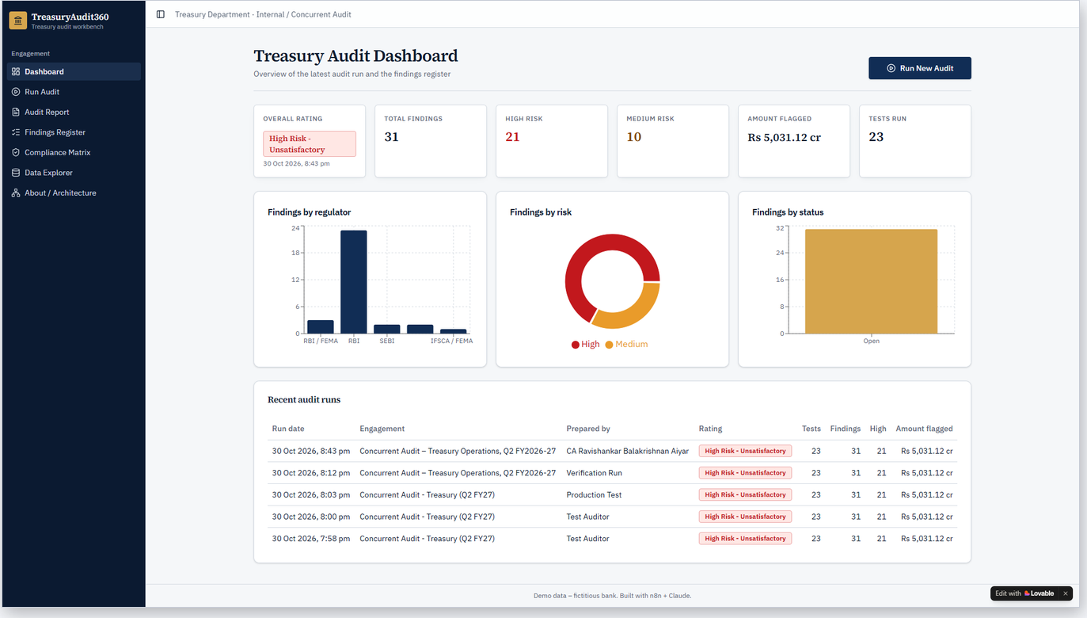
Live demo: the dashboard at a glance
31
findings in the latest run
21
rated High risk
Rs 5,031 cr
amount flagged
CA Ravishankar Balakrishnan Aiyar | Mem. No. 040524 | CAPSTONE PROJECT – TREASURYAUDIT360
8
Notes:
SCENE 5 (screen, 4:10). This is the dashboard for our fictitious bank, Bharat Demo Bank: overall risk rating, number of findings, amount flagged, findings by regulator and severity, and the history of every audit run.

Slide 9
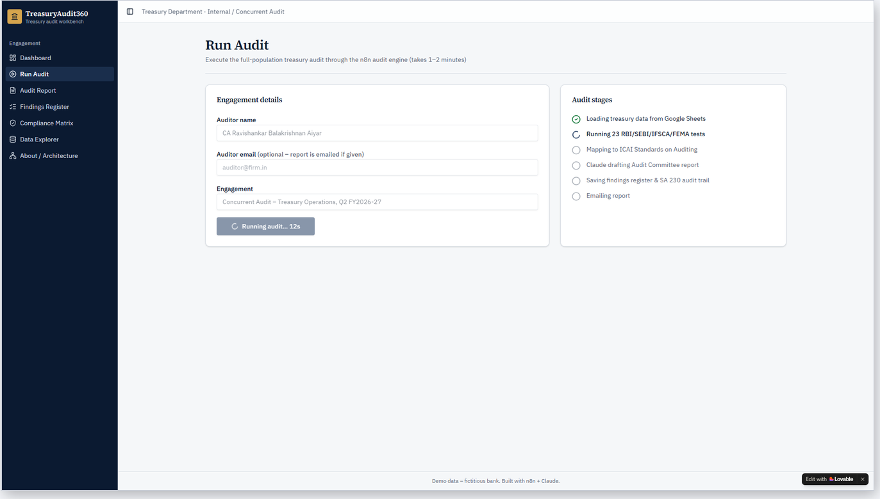
Live demo: one click runs the full audit
1
Read
26 deals and 6 related registers from Google Sheets
2
Test
23 rules on 100% of the records
3
Draft
Claude Sonnet writes the report from the facts
4
Record
Findings, SA 230 trail and email report
CA Ravishankar Balakrishnan Aiyar | Mem. No. 040524 | CAPSTONE PROJECT – TREASURYAUDIT360
9
Notes:
Click Run Audit, enter your name and run. It calls the n8n webhook and takes one to two minutes. Stage one reads the population: 26 deals and the related registers. Stage two runs the 23 tests on 100 percent of the records. Stage three sends only the computed facts to Claude to draft the report. Stage four saves findings and the audit trail and emails the report. (Cut the wait to 5 seconds in editing.)

Slide 10
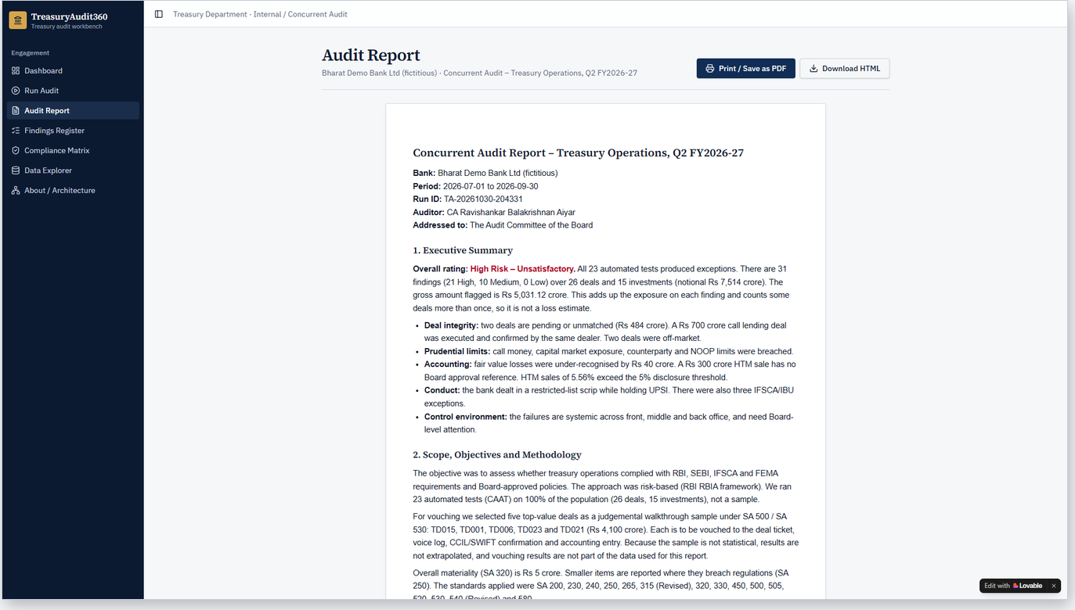
Claude drafts the Audit Committee report
What the report contains
Executive summary with overall rating
Scope, objectives and CAAT methodology
Regulatory compliance matrix
Key observations by regulator
SA 265 control deficiencies
Matters for management response
Drafted by Claude Sonnet 5.5 from computed facts; reviewed by the auditor.
CA Ravishankar Balakrishnan Aiyar | Mem. No. 040524 | CAPSTONE PROJECT – TREASURYAUDIT360
10
Notes:
SCENE 6 (screen, 5:40). This is the Audit Committee report Claude drafted: executive summary, key observations by regulator, SA 265 control deficiencies and a follow-up table. I can print it or save it as PDF.

Slide 11
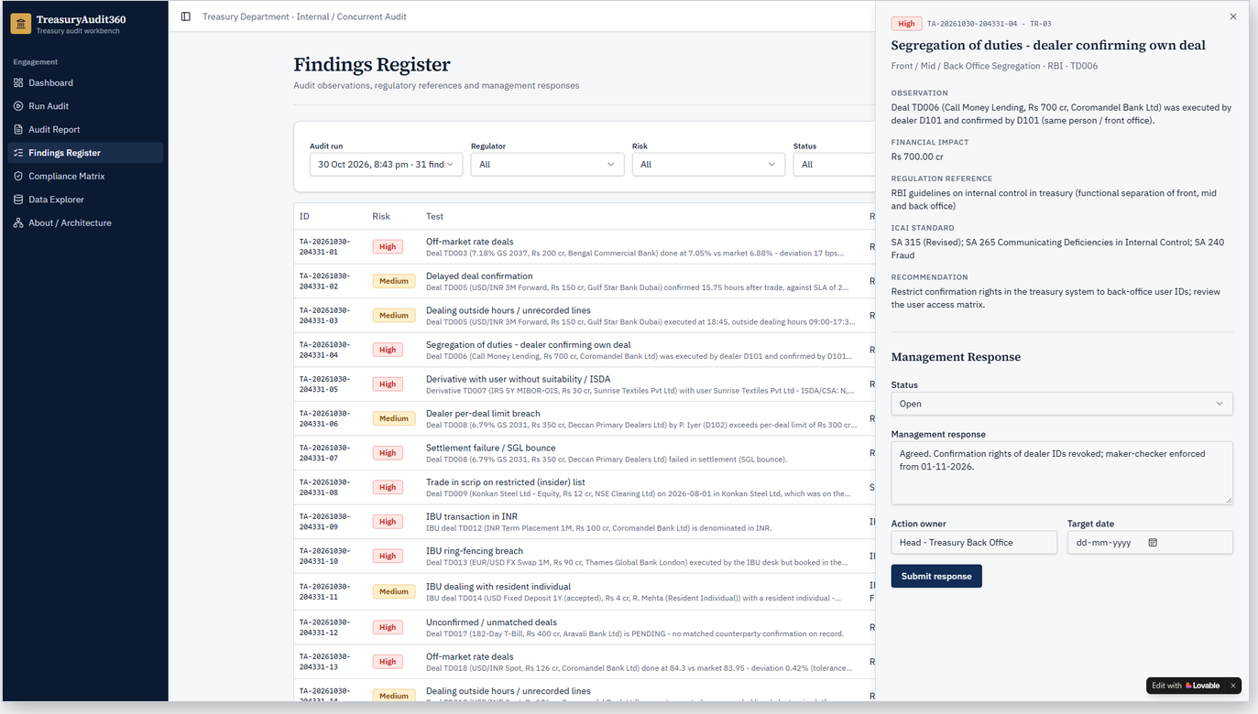
Findings register closes the loop with management
FINDING TD006
Dealer confirmed own deal
Segregation-of-duties failure: SA 315, SA 265
Fraud-risk indicator: SA 240
Management enters response, owner and target date
n8n writes it back to the Findings register
CA Ravishankar Balakrishnan Aiyar | Mem. No. 040524 | CAPSTONE PROJECT – TREASURYAUDIT360
11
Notes:
The Findings Register lists every exception, filterable by regulator or severity. Finding TD006: the same dealer booked and confirmed this deal, a segregation-of-duties failure under SA 315 and SA 265 and a fraud-risk indicator under SA 240. Management responds right here: response, owner and target date. The Google Sheet updates, closing the loop between audit and management.

Slide 12
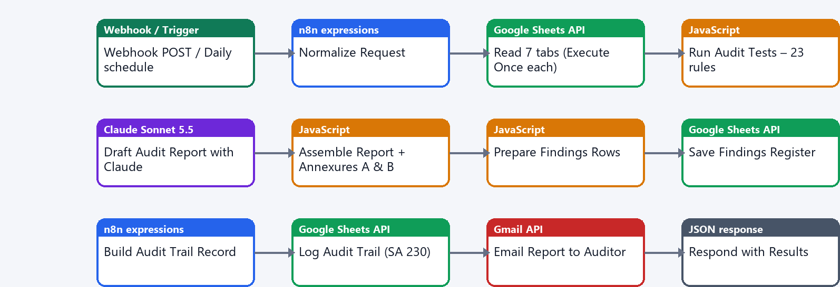
Behind the scenes: the n8n Audit Engine
Generated from TypeScript (n8n Workflow SDK) by Claude Opus 5.5. Node types: Webhook / schedule · n8n expressions · Google Sheets API · JavaScript Code nodes · Claude Sonnet 5.5 · Gmail API · JSON response
CA Ravishankar Balakrishnan Aiyar | Mem. No. 040524 | CAPSTONE PROJECT – TREASURYAUDIT360
12
Notes:
SCENE 7 (screen, 7:20). This is the real n8n workflow. Claude Opus generated it from TypeScript code and published it. Webhook trigger, Normalize, seven Google Sheets reads, then the Run Audit Tests code node, Claude, assembly, findings, audit trail, email and the response to the app.

Slide 13
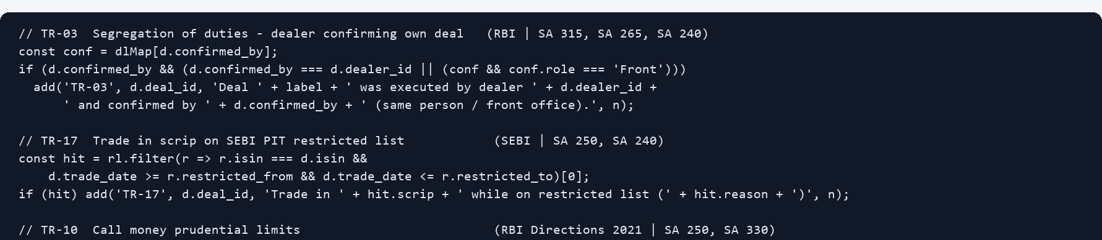
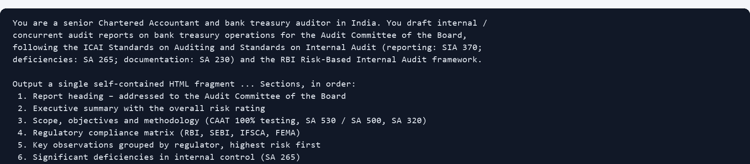
JavaScript rules, and the prompt for Claude
1
JavaScript rule
In an n8n Code node. Thresholds come from the Parameters tab, so a new RBI circular means changing one cell, not the code.
2
Claude system prompt
Plain English. Sets the role and report structure, and says: use ONLY the facts in the JSON.
CA Ravishankar Balakrishnan Aiyar | Mem. No. 040524 | CAPSTONE PROJECT – TREASURYAUDIT360
13
Notes:
Each rule is a few lines of JavaScript. It reads its threshold from the Parameters tab and tags the exception with the regulation and ICAI standard. When RBI issues a new circular, I change one cell, not the code. And here is the prompt for Claude: role, report structure and, most importantly, use only the supplied facts.

Slide 14
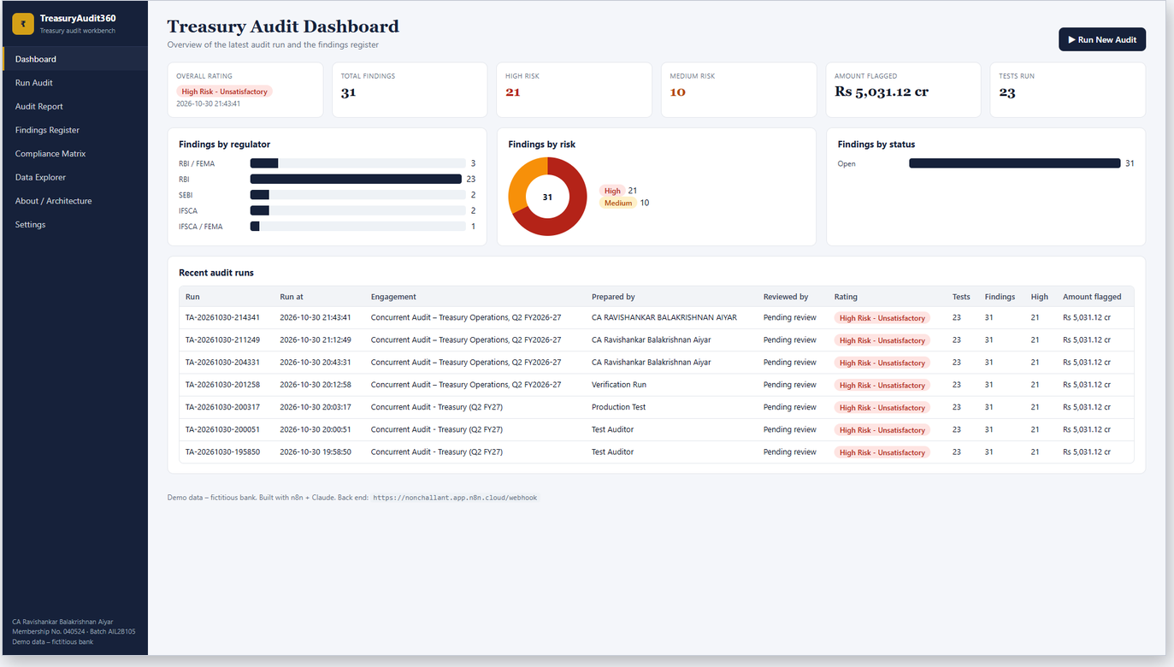
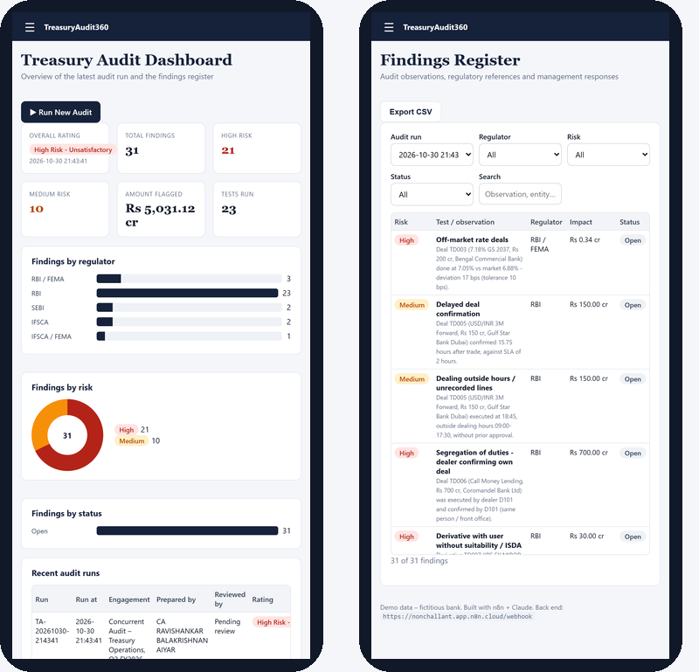
Open on GitHub, installable on Android
GitHub: index.html app, 3 n8n workflow JSONs, sample data CSVs, docs, APK
Android: native Java app, Android 7–16, APK and AAB
CA Ravishankar Balakrishnan Aiyar | Mem. No. 040524 | CAPSTONE PROJECT – TREASURYAUDIT360
14
Notes:
SCENE 8 (screen, 8:40). The whole project is on GitHub: the single-file web app, the three n8n workflows as JSON, sample data and documentation. The same app runs on Android, installable as an APK.

Slide 15
23 tests mapped to regulators and ICAI standards
Test | Check | Regulator | ICAI SA
TR-01/02 | Unconfirmed or delayed deal confirmations | RBI | SA 505, 330
TR-03 | Dealer confirming own deal (segregation of duties) | RBI | SA 315, 265, 240
TR-04/05 | Off-market rates; after-hours or unrecorded deals | RBI / FEMA | SA 240, 520
TR-06/07/08 | Counterparty, dealer and stop-loss limits | RBI | SA 250, 315
TR-09/10/16 | NOOP, call money, capital market exposure | RBI / FEMA | SA 250, 330
TR-11 | Settlement failure / SGL bounce | RBI | SA 330, 505
TR-12–15 | HTM sales, fair-value loss, stale valuation, non-SLR | RBI | SA 540, 450
TR-17 | Trade in restricted-list (UPSI) scrip | SEBI | SA 250, 240
TR-18 | User derivative without suitability / ISDA | RBI | SA 250, 315
TR-19/20/21 | IBU in INR, ring-fencing, resident individual | IFSCA / FEMA | SA 250, 265
TR-22 | KYC-pending counterparty | RBI | SA 250, 240
TR-23 | Holdings vs NSDL / CDSL / SGL | SEBI / RBI | SA 505, 500
CA Ravishankar Balakrishnan Aiyar | Mem. No. 040524 | CAPSTONE PROJECT – TREASURYAUDIT360
15
Notes:
Summarise coverage: 23 tests mapped to the regulator and ICAI standard. Point at TR-03 and TR-17.

Slide 16
Benefits, controls and honest limitations
Benefits
Controls over AI
Limits and next steps
• 100% coverage instead of sampling
• Results in ~2 minutes, not weeks
• Same rules applied every time
• Complete SA 230 audit trail
• Rules decide every finding
• Claude uses computed facts only
• CA reviews and signs the report
• Data fingerprint on every run
• Demo data is fictitious
• Verify thresholds against current circulars
• Add webhook authentication; self-host n8n in India
• Next: CCIL and NSDL/CDSL feeds, daily runs
CA Ravishankar Balakrishnan Aiyar | Mem. No. 040524 | CAPSTONE PROJECT – TREASURYAUDIT360
16
Notes:
SCENE 9 (face, 9:20). Controls: rules decide, AI only drafts, a CA reviews and signs. Limitations: the data is fictitious and every threshold must be checked against current circulars; the demo webhooks need authentication in production. Benefits: 100 percent coverage instead of sampling, results in two minutes instead of weeks, consistent rules, and a complete audit trail.

Slide 17
Thank you
Complete, faster, consistent treasury audits, with judgement kept with the CA
Live app
treasuryaudit360.lovable.app
Code
GitHub · TreasuryAudit360
Built with
n8n · Claude Opus 5.5 · Claude Sonnet 5.5 · Lovable
CA Ravishankar Balakrishnan Aiyar | Mem. No. 040524 | CAPSTONE PROJECT – TREASURYAUDIT360
17
Notes:
SCENE 10 (face, 10:00-10:20). To sum up: TreasuryAudit360 shows how a chartered accountant can combine automation and AI to audit a bank treasury faster, more completely and more consistently, while keeping professional judgement with the auditor. The live app is at treasuryaudit360.lovable.app and the code is on GitHub. Thank you.

